Slide 1
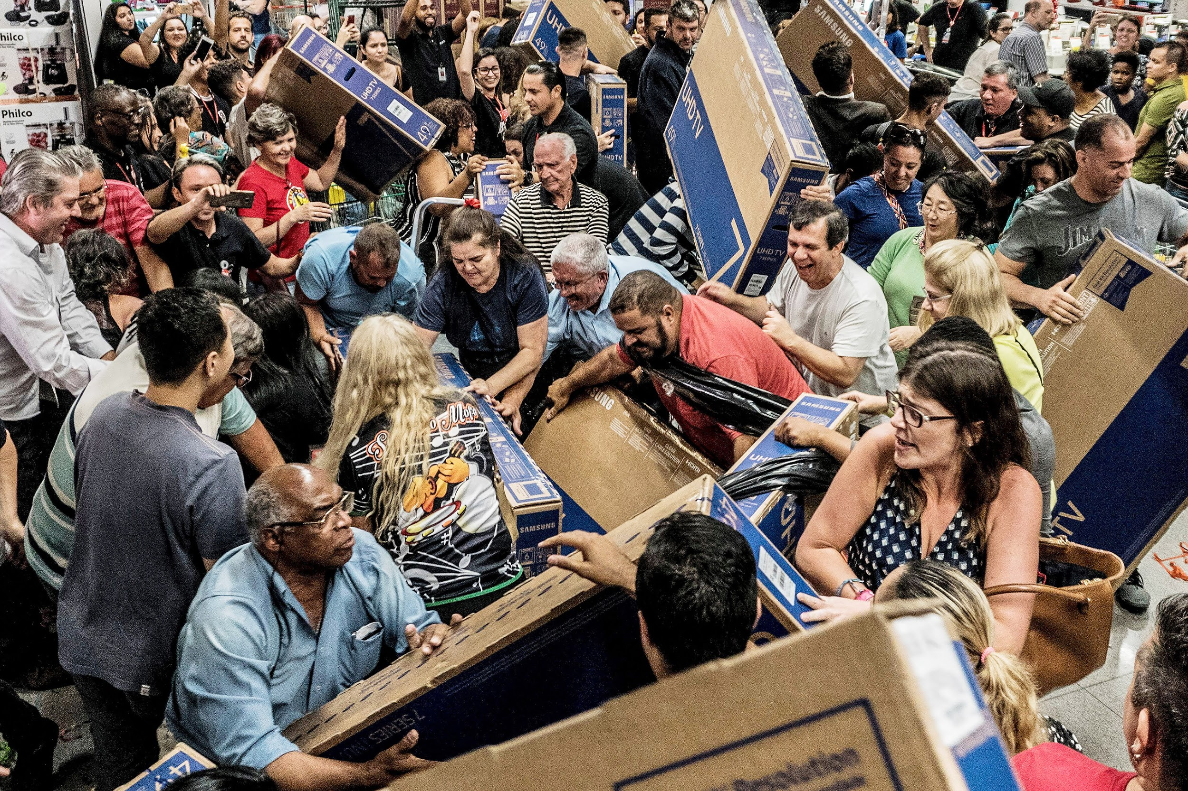
BLACK FRIDAY SALES ANALYSIS OF A RETAIL STORE
Akhil Prasad
Akkshay Bhakta
Girish Pachala
Siddhesh Inamdar

Slide 2
Problem Statement
To find out the customer purchase behavior against different products in a retail store.
To increase the Black Friday Sales of the retail store based on the demographics like gender and age.
Compare who spends more money between male or female. We find out which age category spend the most, and in which city.
To predict the dependent variable (the amount of purchase) with the help of the information contained in the other variables.

Slide 3

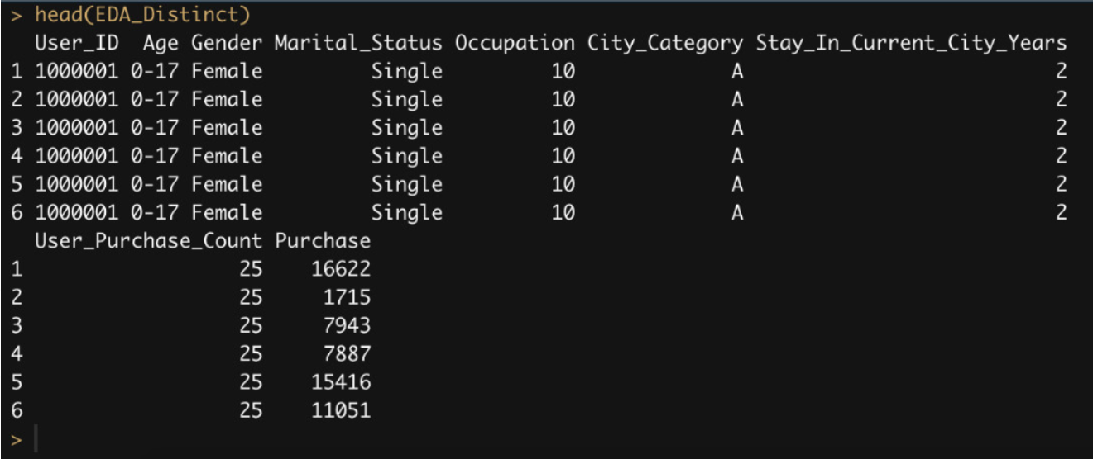
HELLO!
Dataset
The dataset consists of 12 variables out of which we perform data visualizations on
Gender
Age
Marital status
City Category
Occupation
Product categories
Total purchase for each row
Purchase count
Product categories 1 and 2 contains NaN values.

Slide 4
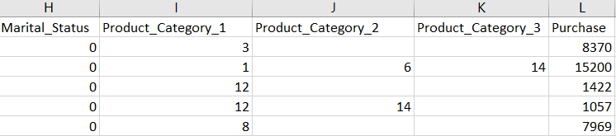
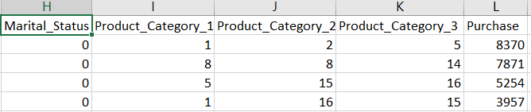
Data Cleaning
Since our data is stored based on product id i.e. if a person is buying 10 products then his data will be stored in 10 observations and hence there will be a repetition of the data for the same user.
Removed the NAN values

Slide 5
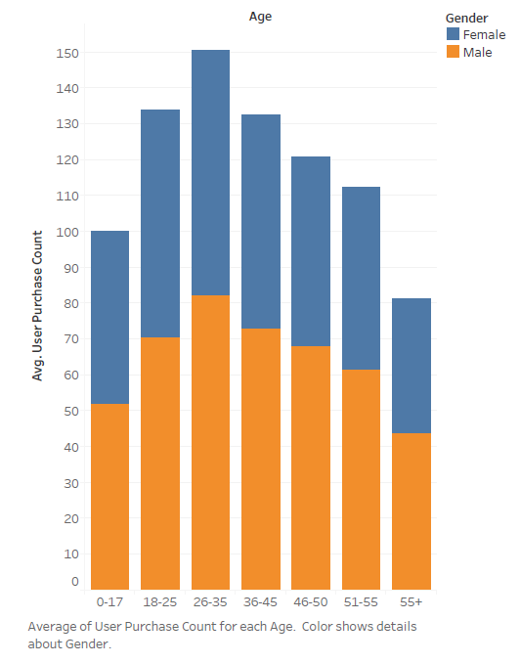
Exploratory analysis using Tableau
The analysis is between Age and Average purchase count with gender filter
Average Purchase Count (High) | Gender | Age
86.24 | Male | 26-35
68.10 | Female | 26-35
Average Purchase Count (low) | Gender | Age
44.01 | Male | 55+
37.18 | Female | 55+

Slide 6
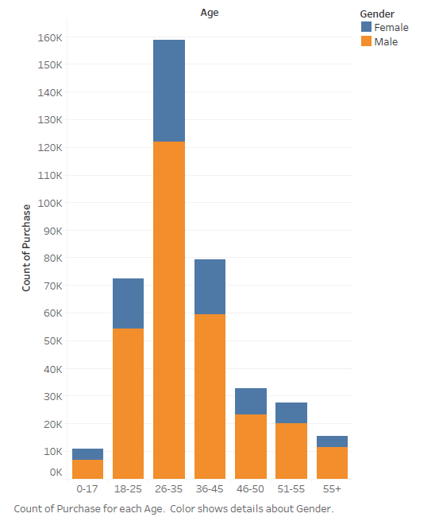
Exploratory analysis using Tableau
The analysis is between Age and Count purchase(in dollars).
Count Purchase (Highest) | Gender | Age
1,22,144 | Male | 26-35
36,476 | Female | 26-35
Count Purchase (lowest) | Gender | Age
7,240 | Male | 0-17
3,638 | Female | 55+

Slide 7
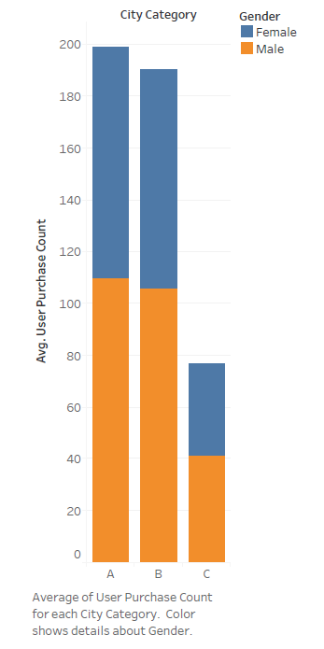
Exploratory analysis using Tableau
The analysis is between City Category and Average purchase count with a gender filter.
Average Purchase Count | Gender | City Category
109.94 | Male | A
88.84 | Female | A
105.84 | Male | B
84.83 | Female | B
41.41 | Male | C
35.22 | Female | C

Slide 8
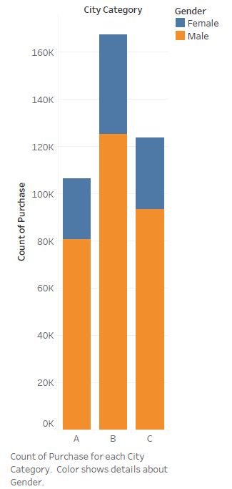
Exploratory analysis using Tableau
The analysis is between City Category and Count Purchase(in dollars) with a gender filter.
Count Purchase | Gender | City Category
80,655 | Male | A
25,633 | Female | A
1,25,427 | Male | B
41,775 | Female | B
93,366 | Male | C
30,349 | Female | C

Slide 9
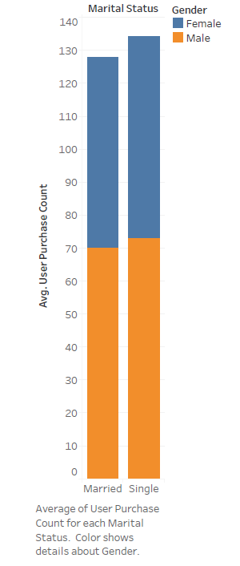
Exploratory analysis using Tableau
The analysis is between Marital Status and Average purchase count with a gender filter.
Average Purchase Count | Gender | Marital Status
70.31 | Male | Married
57.63 | Female | Married
73.09 | Male | Single
61.05 | Female | Single

Slide 10
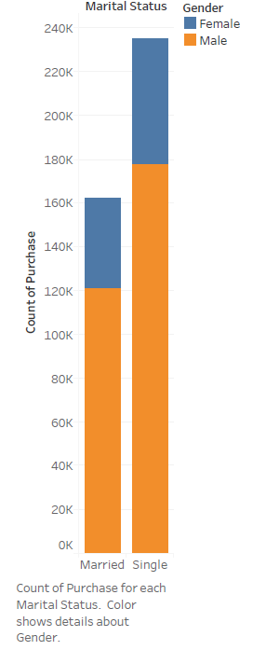
Exploratory analysis using Tableau
The analysis is between Marital Status and Count purchase(in dollars) with a gender filter.
Count Purchase | Gender | Marital Status
1,21,518 | Male | Married
40,833 | Female | Married
1,77,930 | Male | Single
56,924 | Female | Single

Slide 11
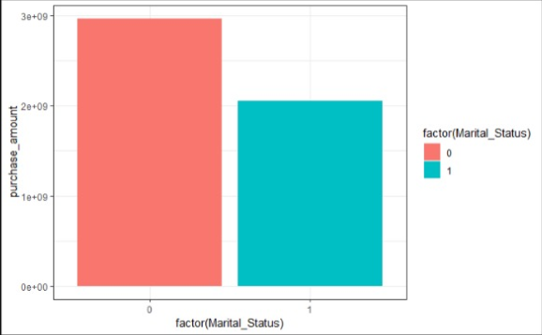
EXPLORATORY DATA ANALYSIS

Slide 12
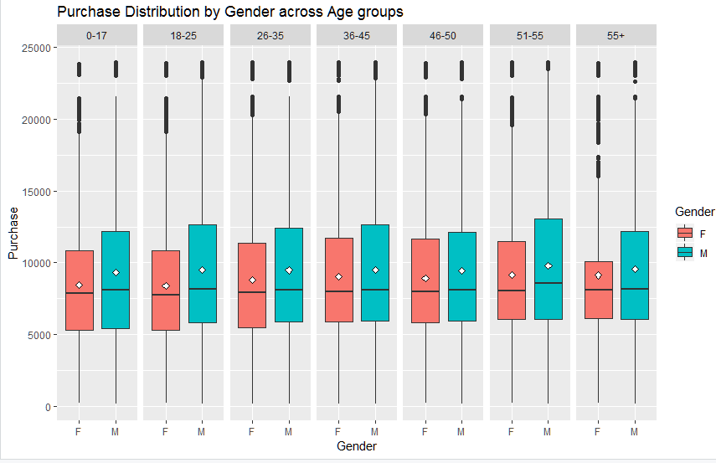
BOXPLOT REPRESENTING PURCHASE DISTRIBUTION BY GENDER ACROSS AGE GROUPS
Male average purchases were clearly higher as compared to females.
Another thing to notice is that there is a huge difference among age groups of females (0-17,18-25 with 26-35, 36-45)
Also, males of age group 51-55 spent the most among all.

Slide 13
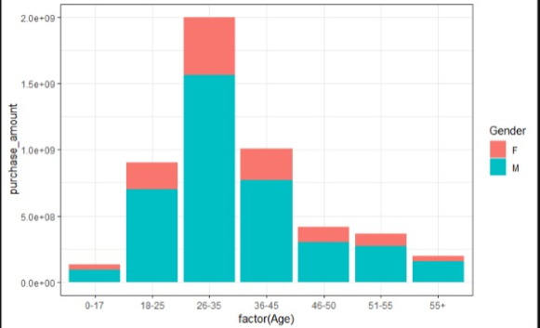
EXPLORATORY DATA ANALYSIS

Slide 14
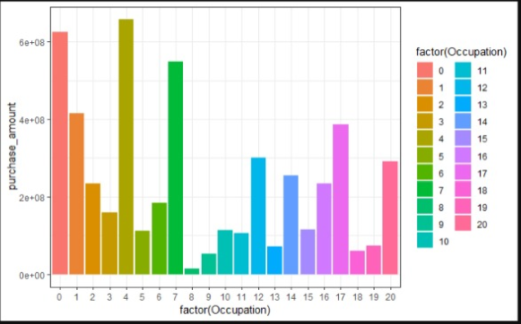
EXPLORATORY DATA ANALYSIS

Slide 15
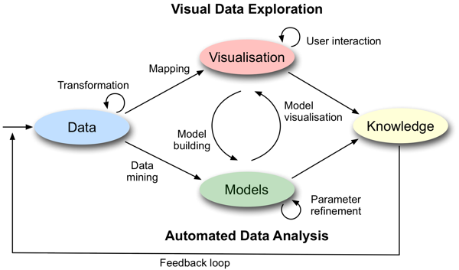
Models
Linear Regression:
Linear regression is a linear approach to modelling the relationship between a scalar response (or dependent variable) and one or more explanatory variables (or independent variables).
It is the most commonly used type of predictive analysis.
The goodness of the model is evaluated using the measure R^2 (R squared) .The higher the R^2 the better the fit.

Slide 16
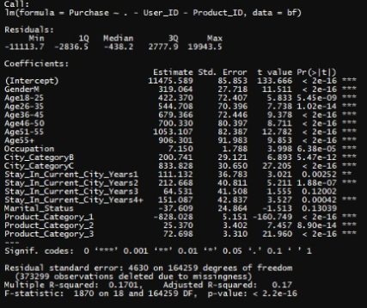
Regression
From the data set we aim to predict Purchase estimate, so our target variable will be “Purchase”
From the first linear regression, the estimated standard error for marital status was -37.6 and Product_Category is -829.02, since it is insignificant we remove the column.
RMSE value is 4630.

Slide 17
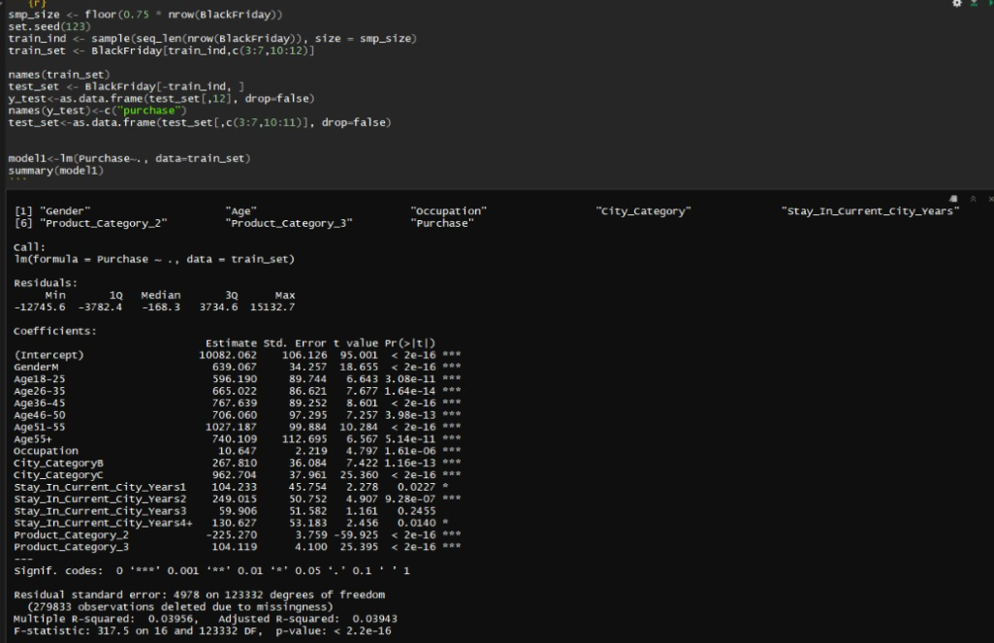
Regression

Slide 18
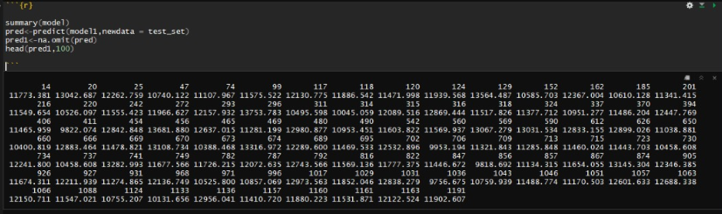
Regression
Predicted values for the next 100 rows

Slide 19
CONCLUSION
Age group 25-35 spend the most among different age groups.
Males spend more than Female in all age group
City B had most sales with a Count Purchase of 1,25,427 and 41,775 by Men and Women respectively
Occupation no. 4 had the most purchases while occupation no. 8 had the least purchases made during black friday.
The RMSE value comes around 4978 which is very high and thus linear regression model is not appropriate for this dataset

Slide 20
THANK YOU

